Slide 1
PhishLens: An Interpretable and Lightweight Framework for Phishing URL Detection Using URL Features
Team Members
REVANTH P (2303737710421041)
SABARISH M (2303737710421043)
23.09.2026

Slide 2
2. Introduction & Background
Phishing remains a widespread entry vector in cyberattacks, relying on deceptive URLs to steal user credentials, financial data, and sensitive records.
Traditional defensive mechanisms rely on static blacklists and rule-based heuristics, which fail against short-lived, automated zero-day phishing links.
Fetching and parsing webpage DOM or rendering screenshots introduces heavy computational overhead and exposes client devices to drive-by malware.
Machine Learning enables automated identification of patterns directly within the web address, pure URL-based analysis eliminates page-rendering overhead, providing pre-click, lightweight, and millisecond-level threat detection.

Slide 3
3. Problem Statement & Relevance
Refined Problem Statement: Developing an accurate, low-latency classification framework capable of detecting newly generated phishing URLs strictly from syntactic and topological features without accessing external webpage content.
Relevance: Security operations and end-users require immediate threat classification paired with clear justifications, avoiding the opaque "black-box" nature of complex neural networks.
Limitations of Existing Tools: Relying on a single feature category (lexical-only or structural-only) fails to capture modern URL obfuscation and brand-spoofing tactics.
Changes Made After Zeroth Review: Standardized the feature space into a formal 21-dimensional hybrid vector (13 lexical + 8 structural) and integrated SHAP (SHapley Additive exPlanations) for human-readable risk attribution.

Slide 4
4. Updated Literature Survey
Year | Author(s) | Method / Approach | Dataset | Accuracy
2022 | Al-Ahmadi et al. | Supervised ML Classifiers | URL Lexical analysis | High lexical correlation, but lacked structural depth.
2021 | Singh et al. (BASE PAPER) | Hybrid Feature ML Method | Lexical + Domain structural features | Demonstrates superior detection by combining textual.
2023 | ICCNS Conference | Feature Count & Timing Analysis | Optimized feature sets | Highlights trade-off between feature size and training/ latency.
2019 | Emerging XAI Studies | TreeExplainer + ML | Tabular cyber threat metrics | Identifies need for real-time, local instance explanation.

Slide 5
5. Research Gap / Identified Problem
Consolidated Research Gap: Existing tools enforce an operational trade-off between detection latency, feature completeness, and algorithmic transparency.
Limitation of Existing Approaches:
  Deep learning models (CNN/RNN/BERT) offer high accuracy but require heavy runtime environments and GPU resources, rendering client-side edge deployment impractical.
Absence of Interpretability: Existing classifiers output binary labels without explaining why an address is malicious.
How PhishLens Addresses the Gap: Constructs a 21-feature hybrid representation, classifies using an optimized lightweight tree ensemble, and leverages SHAP TreeExplainer to produce interpretable risk factors in real time

Slide 6
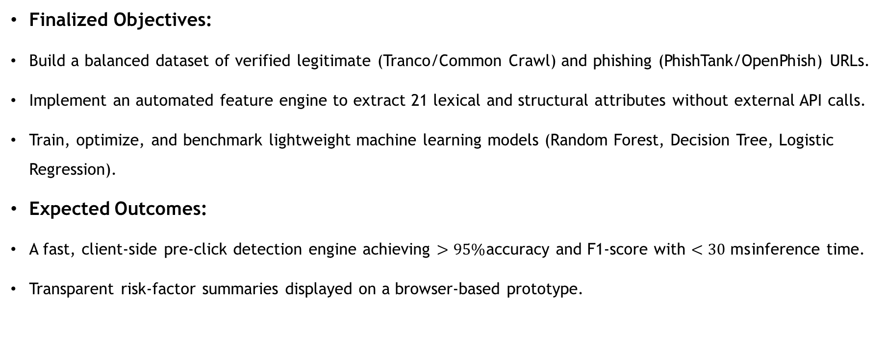
6. Project Objectives & Expected Outcomes
Finalized Objectives:
Build a balanced dataset of verified legitimate (Tranco/Common Crawl) and phishing (PhishTank/OpenPhish) URLs.
Implement an automated feature engine to extract 21 lexical and structural attributes without external API calls.
Train, optimize, and benchmark lightweight machine learning models (Random Forest, Decision Tree, Logistic Regression).
Expected Outcomes:
A fast, client-side pre-click detection engine achieving $>95\%$accuracy and F1-score with $<30\text{ ms}$inference time.
Transparent risk-factor summaries displayed on a browser-based prototype.

Slide 7
7. System Architecture / Design
Input & Preprocessing: Sanitizes raw URL strings, parses protocol schemes, and unescapes hexadecimal encodings.
Feature Extraction Engine (feature_extractor.py): Simultaneously extracts lexical syntax markers and topological domain characteristics into a 21-element vector.
Classification Core (model.py / classifier.pkl): Random Forest ensemble computes classification probability.
Explainability Layer (explainability.py): SHAP TreeExplainer generates local feature attributions.
Presentation Layer (app.py + UI): Displays binary verdict (Legitimate/Phishing), confidence meter, and top 3 reason codes

Slide 8
System Architecture / Design

Slide 9
9. Module-wise Progress
Modules finalised: URL Preprocessing, 21-D Feature Extraction, ML Classification, and SHAP Explainability.
Completed: Implementation of the 21 lexical/structural feature extractors (feature_extractor.py) and training/serialization of the Random Forest model (classifier.pkl).
Ongoing: Full integration of the SHAP TreeExplainer reasoning pipeline (explainability.py) and connection with the interactive web dashboard
Individual contribution: Revanth P — dataset preprocessing, model training, evaluation, and backend API; Sabarish M — 21-feature extraction logic, entropy computation, and SHAP explainability module.

Slide 10
10. Implementation / Preliminary Results
Initial outputs: 21-dimensional hybrid feature extraction engine and normalization pipeline implemented and verified across sample legitimate and phishing URLs.
Prototype in progress: Random Forest ensemble classifier trained and serialized; end-to-end inference and SHAP local attribution pipeline completed for validation.
Target benchmarks (from base literature, to validate against): 96.2% accuracy and 96.2% F1-score with under 15 ms inference latency at an 80:20 train/test split.
Observation: Tree-based ensemble achieves high detection without deep learning overhead, and local SHAP values reliably isolate key risk triggers (such as entropy, hyphens, and keyword flags).

Slide 11
11. Project Progress & Updated Timeline
Work Completed: Feature extraction engine, Random Forest serialization, SHAP reason mapper, and backend API setup.
Current Status: 60% Overall Completion.
Pending Activities: Large-scale dataset expansion, browser client latency stress testing, and UI styling polish.
Revised Timeline for Subsequent Phases:
  Phase 2 (Weeks 4–6): Scale dataset to 50k+ samples, perform grid search hyperparameter tuning.
  Phase 3 (Weeks 7–9): Finalize full-stack web dashboard and conduct false-positive stress tests.
  Phase 4 (Weeks 10–14): Benchmark against third-party blacklist feeds and prepare final documentation.

Slide 12
12. Conclusion & Next-Phase Plan
Current Status: Core algorithms, extraction pipelines, and interpretability modules are implemented and verified.
Key Achievements: Verified that a 21-feature hybrid vector detects phishing patterns accurately with millisecond latency, without external DOM scraping.
Remaining Work: Finalize front-end UI visualizers, conduct adversarial evaluation against homograph attacks, and scale data coverage.
Plan for Completion: Complete the web client integration, optimize inference speed, and assemble the final project report for Phase 2 review.

Slide 13
References
“URL Phishing Detection using Machine Learning Techniques based on URLs Lexical Analysis,” IEEE ICICS, 2021.
“Hybrid Feature-Based Machine Learning Method for Phishing URL Detection,” IEEE ICSCCC, 2023.
“Optimizing Phishing URL Detection: A Comparative Analysis of Feature Counts and Training Times,” IEEE ICCNS, 2024.
“Cyber Sentinel: Intelligent Phishing URL Identification System Employing Machine Learning Methods,” IEEE ICISC, 2024.
S. M. Lundberg and S.-I. Lee, “A Unified Approach to Interpreting Model Predictions,” Advances in Neural Information Processing Systems (NeurIPS), 2017.

Slide 14
Thank You !

